Slide 1
NETWORK ADDRESS TRANSLATION

Slide 2
PRIVATE IP
PUBLIC IP
CLASS A
Are internet routable
10.0.0.0 — 10.255.255.255
CLASS B
Should be globally unique
172.16.0.0 — 172.31.255.255
CLASS C
192.168.0.0 — 192.168.255.255

Slide 3


Internet
... | Source IP | Destination IP | ...
... | 10.0.0.1 | 200.100.50.25 | ...
... | Source IP | Destination IP | ...
... | 160.80.40.20 | 200.100.50.25 | ...
NAT
... | Source IP | Destination IP | ...
... | 200.100.50.25 | 10.0.0.1 | ...
... | Source IP | Destination IP | ...
... | 200.100.50.25 | 160.80.40.20 | ...
NAT

Slide 4
SUMMARY

Slide 5
DOMAIN
NAME
SYSTEM

Slide 6
URL
Protocol
Domain Name
Directory
https://www.example.com/2023/samples/index.html
Hostname
TLD
File Name

Slide 7

Recursive
Resolver
ROOT
DNS
AUTHORITATIVE
SERVER
TLD
SERVER

Slide 8
DYNAMIC DNS
STATIC DNS
  Automatically updates the data in DNS servers
  IP addresses of Domains are signed and changed manually
  Provides valid data, even if the ip addresses are frequently updated
  Is easy to configure, and is less prone to errors.

Slide 9
Record CNAME
(Canonical name)
Record AAAA
(Host IPv6)
Record A
(Hostname)
Record SRV
(Service)
DNS RECORD TYPES
Record MX
(Mail exchange)
Record PTR
(Pointer)
Record PTR
(Pointer)
Record NS
(Name server)

Slide 10
SUMMARY

Slide 11
ADDRESS
RESOLUTION
PROTOCOL

Slide 12

MAC Address
Unique Identifier
00-04-5A-64-AI-66
Vendor

Slide 13

Who is 10.0.0.4?
I need your MAC Address
I am not 10.0.0.4
I will drop this frame
I am not 10.0.0.4
I will drop this frame
I am 10.0.0.4
Here is my MAC Address

Slide 14
SUMMARY

Slide 15
DYNAMIC
HOST
CONFIGURATION
PROTOCOL

Slide 16

STATIC IPs
10.0.0.4/24
10.0.0.1
8.8.8.8

Slide 17
Source | Destination
0.0.0.0 | 255.255.255.255
DISCOVER
0.0.0.0
Source | Destination
10.0.0.10/24 | 255.255.255.255
OFFER
Source | Destination
10.0.0.15/24 | 10.0.0.10/24
REQUEST
Source | Destination
10.0.0.10/24 | 10.0.0.15/24
ACK

Slide 18
DHCP OPTIONS
OPTION 1 — Subnet Mask
OPTION 15 — Domain
OPTION 3 — Gateway
OPTION 6 — DNS
OPTION 28 — Broadcast
OPTION 51 — Lease
OPTION 66 — TFTP
OPTION 42 — NTP

Slide 19
SUMMARY

Slide 20
TYPES OF
NETWORK
MEDIAS

Slide 21
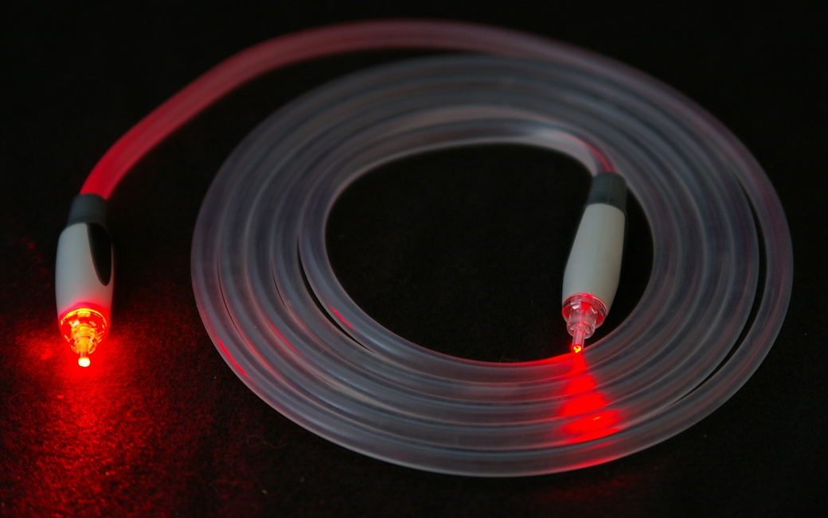
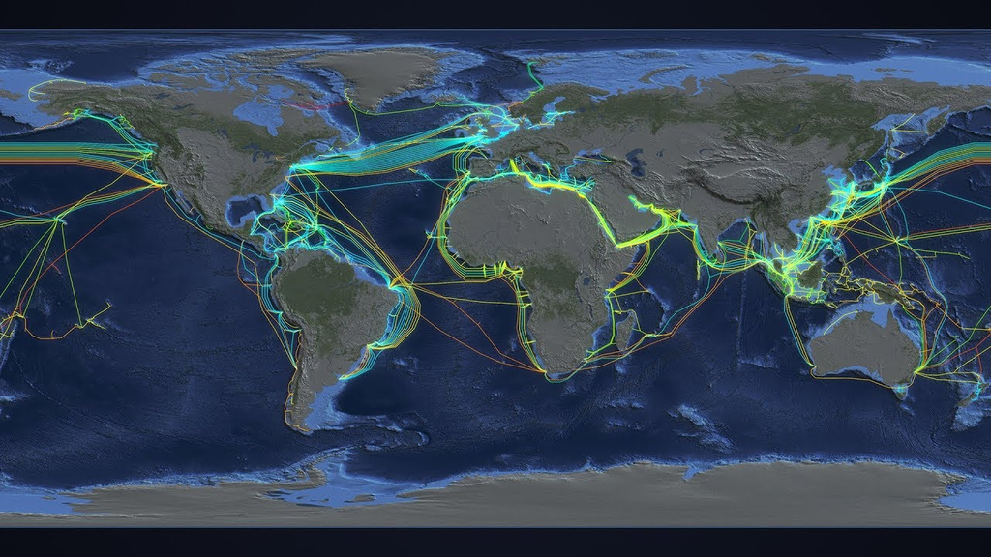
FIBER—OPTIC

Slide 22


WIRELESS

Slide 23
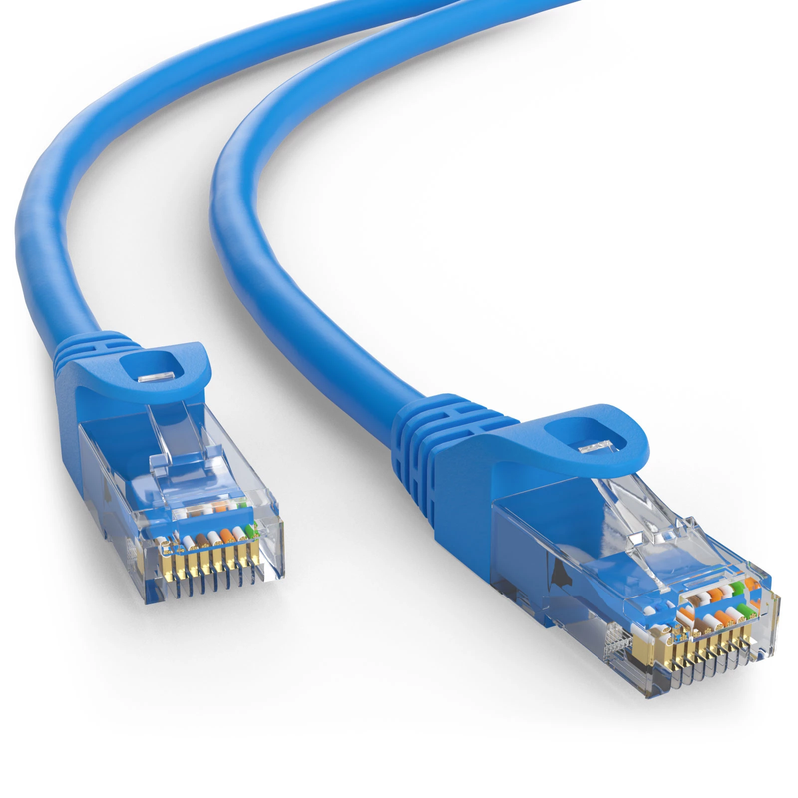
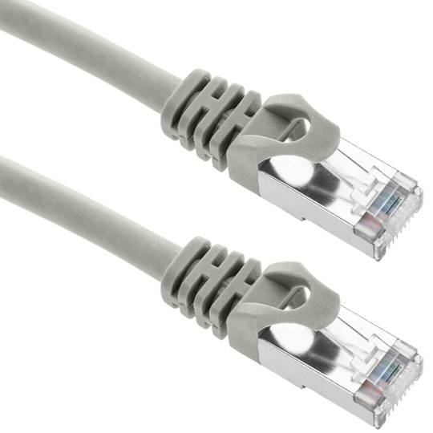
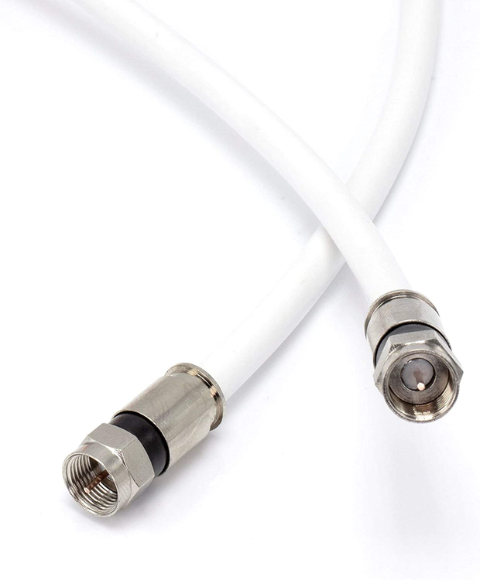
COPPER WIRING

Slide 24
SUMMARY

Slide 25

THANK YOU
FOR YOUR
ATTENTION

