Slide 1





ENGS271: Systems Engineering
Intro
Supplies
Distros
Process
Installing
GNU/LINUX
A VISUAL GUIDE
Dina Sharifi
Engineering Sciences
AUA CSE

Slide 2


ENGS271: Systems Engineering
Intro
Supplies
Distros
Process
  A USB drive (8GB or larger)
  A computer to install on
  An internet connection
WHAT YOU’LL NEED
Warning
Back Up Your Data!
This process with erase your hard drive. Make sure all your important files, photos, and documents are saved safely on an external drive or cloud service.
Dina Sharifi
Engineering Sciences
AUA CSE

Slide 3




ENGS271: Systems Engineering
Intro
Supplies
Distros
Process
PICK A DISTRO
GNU/Linux comes in different “distributions”, which are pre-packaged versions of the OS.
Recommended for Beginners:
Ubuntu
Fedora
Debian
‘Linux for Human Beings’
  First-time GNU/Linux users
Ease of use, extensive documentation, massive community
‘Bleeding Edge’
  Developers, sysadmins, open-source enthusiasts
Latest software and features
Enabled enhanced security
‘The Universal Operating System’
  Sysadmins, Server users
Extreme stability over latest software
Dina Sharifi
Engineering Sciences
AUA CSE

Slide 4
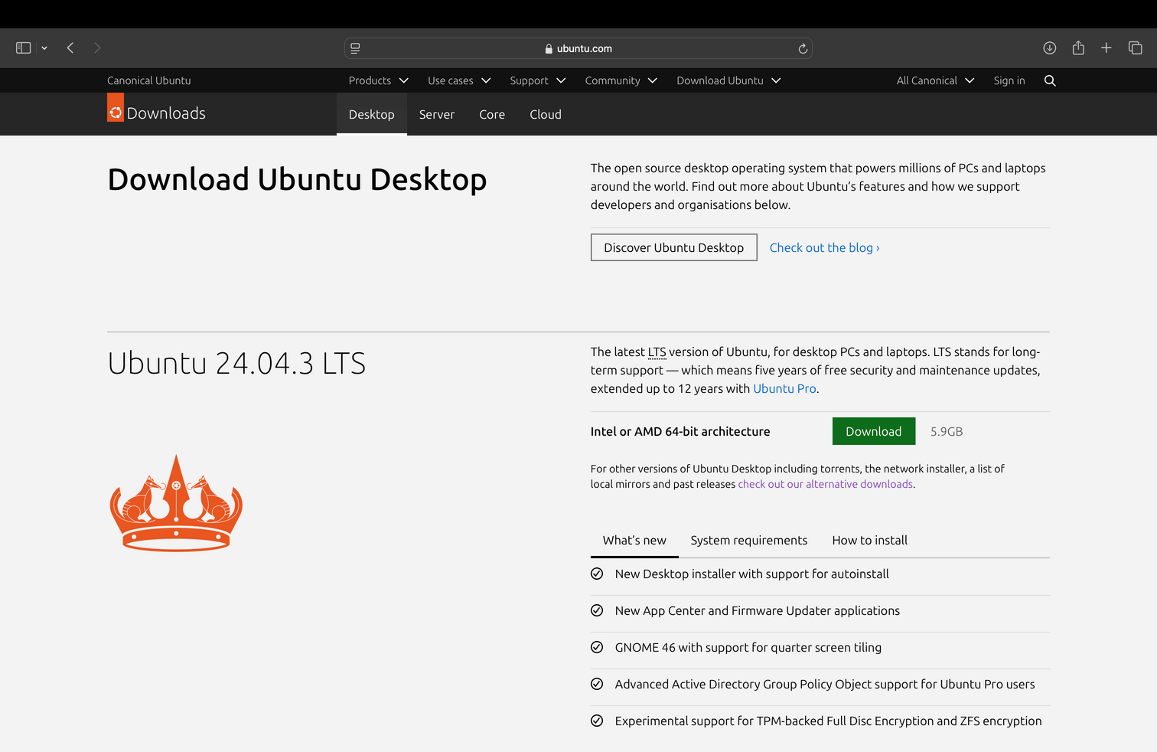

ENGS271: Systems Engineering
Intro
Supplies
Distros
Process
DOWNLOAD THE OS IMAGE
  Go to the official website of your chosen distro.(e.g. ubuntu.com/download/desktop)
  Download the “ISO” file. This is a disk image of the operating system.
Dina Sharifi
Engineering Sciences
AUA CSE

Slide 5
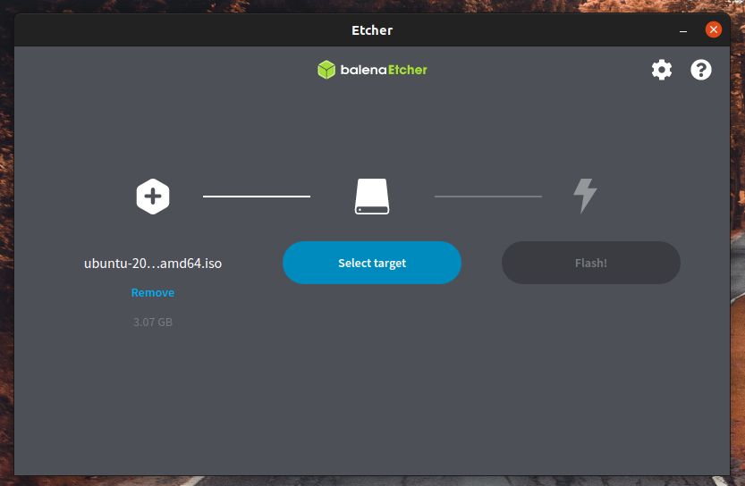
ENGS271: Systems Engineering
Intro
Supplies
Distros
Process
MAKE A BOOTABLE USB INSTALLER
We need to put the ISO file onto the USB drive in a special way. You can use tools like Balena Etcher or Ventoy.
  Plug in your USB drive
  Open Balena Etcher
  “Select Image” → choose your downloaded ISO file
  “Select Target” → choose your USB drive
  Click “Flash!” and wait for it to finish
ubuntu.com
Dina Sharifi
Engineering Sciences
AUA CSE

Slide 6
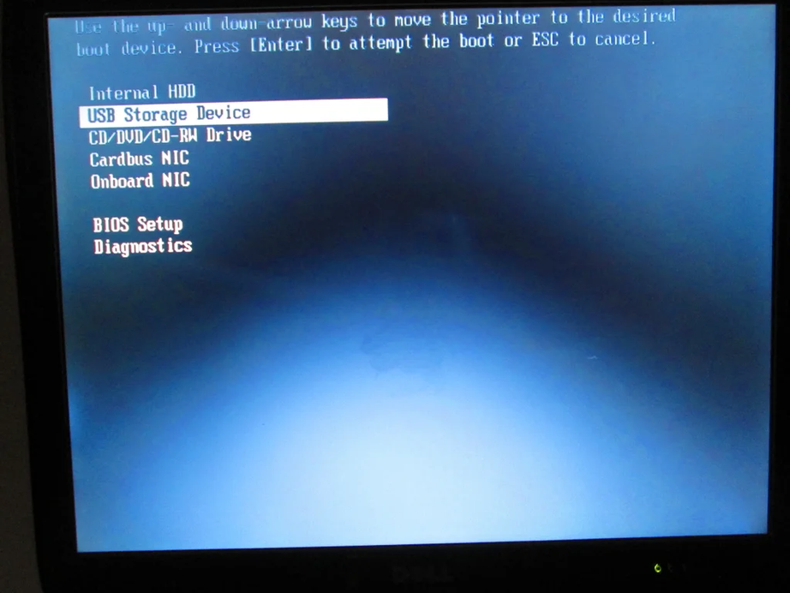
ENGS271: Systems Engineering
Intro
Supplies
Distros
Process
BOOT FROM USB DRIVE
  Plug the USB drive into the computer you want to install on
  Restart the computer
  Immediately press the key to enter the Boot Menu (F12/F10/F2/Esc/Del)
  Select your USB drive from the menu and press Enter
www.instructables.com
Dina Sharifi
Engineering Sciences
AUA CSE

Slide 7
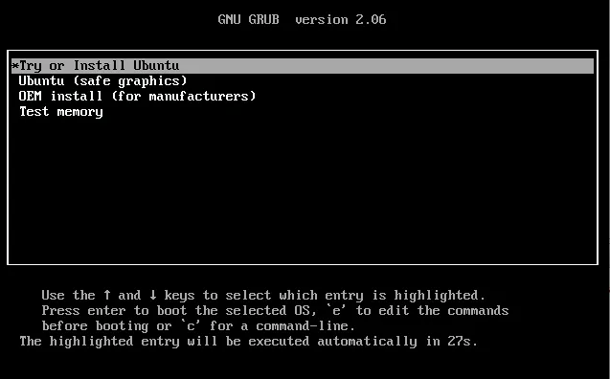
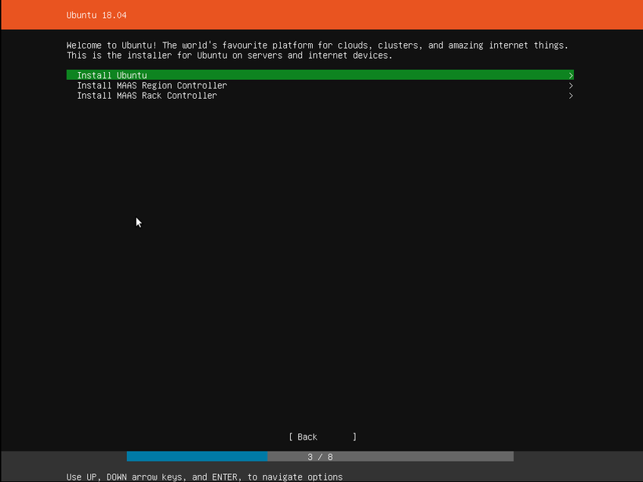
ENGS271: Systems Engineering
Intro
Supplies
Distros
Process
TRY OR INSTALL
www.itprotoday.com
Your computer will now load a “Live Environment” from the USB.
You can try it without making changes to your computer.
When you’re ready, double-click the “Install...” icon on the desktop to begin the permanent installation.
ubuntu.com
Dina Sharifi
Engineering Sciences
AUA CSE

Slide 8
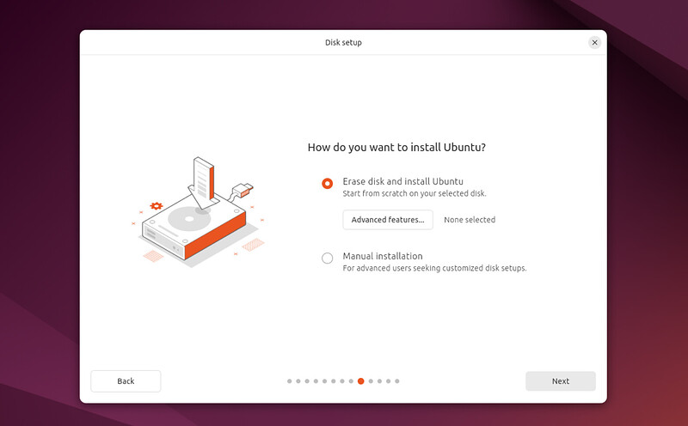
ENGS271: Systems Engineering
Intro
Supplies
Distros
Process
FOLLOW THE INSTALLER
The installer will guide you through:
  Language & Keyboard: Choose your preferences
  Update & Other Software: It’s advised to select ‘Download updates during installation’
  Installation Type: Be careful here. For ease and convenience, select ‘Erase disk and install GNU/Linux”.
Click “Install Now” and confirm the changes to the disk.
ubuntu.com
Dina Sharifi
Engineering Sciences
AUA CSE

Slide 9
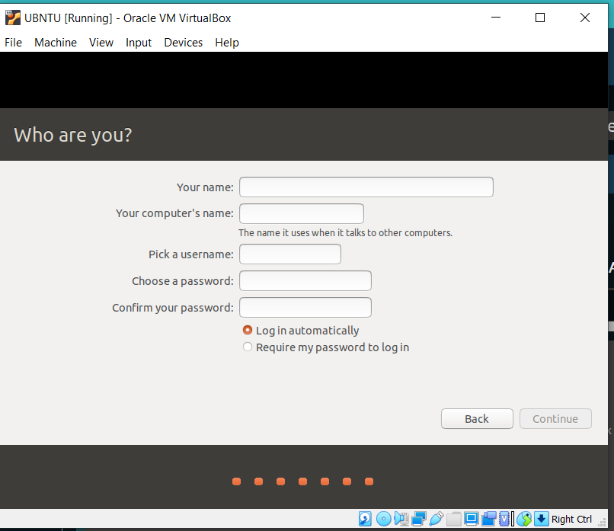
ENGS271: Systems Engineering
Intro
Supplies
Distros
Process
WHERE, AND WHO?
Select your location on the map.
For the User Account:
  Enter your name
  Choose a computer name
  Pick a username and a strong password
forum.level1techs.com
Dina Sharifi
Engineering Sciences
AUA CSE

Slide 10
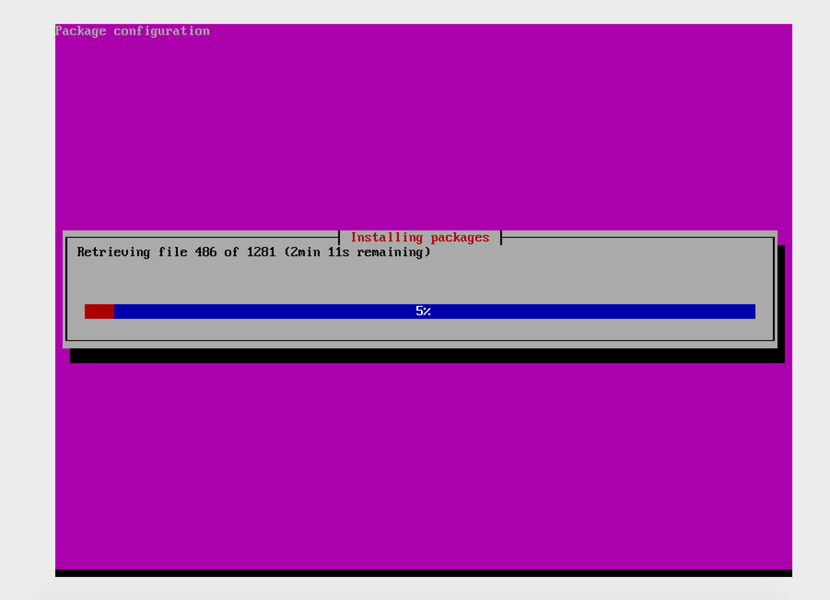
ENGS271: Systems Engineering
Intro
Supplies
Distros
Process
NOW JUST WAIT
The installer will now copy files and set up the system. This may take a few minutes.
When complete, you will be prompted to restart the computer.
Remember to remove the USB drive when it asks you to!
ubuntu.com
Dina Sharifi
Engineering Sciences
AUA CSE

Slide 11
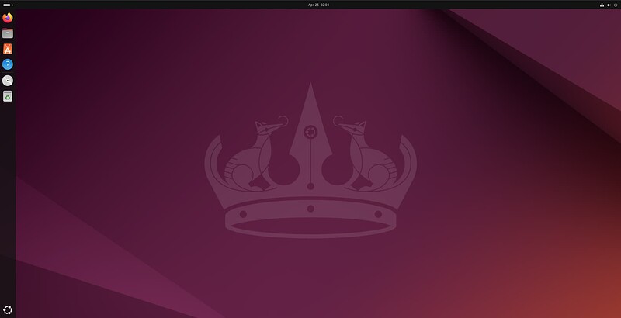
ENGS271: Systems Engineering
Intro
Supplies
Distros
Process
GREAT WORK!
Your computer will now boot directly into your new GNU/Linux system.
Log in with the password you created and explore your free, powerful, and secure new operating system!
ubuntu.com
Dina Sharifi
Engineering Sciences
AUA CSE

Slide 12

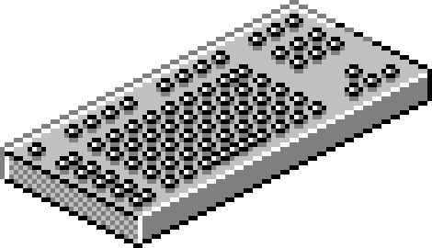

ENGS271: Systems Engineering
WHERE TO LEARN MORE?
Official Documentation: Always the best place to start.
Community forums: Get help from friendly experts.
Software Centers: Discover thousands of free applications.
THANK YOU!
Dina Sharifi
Engineering Sciences
AUA CSE

